Slide 1

Adobe Analytics Challenge 2022
Team Titans
University of Washington

Slide 2
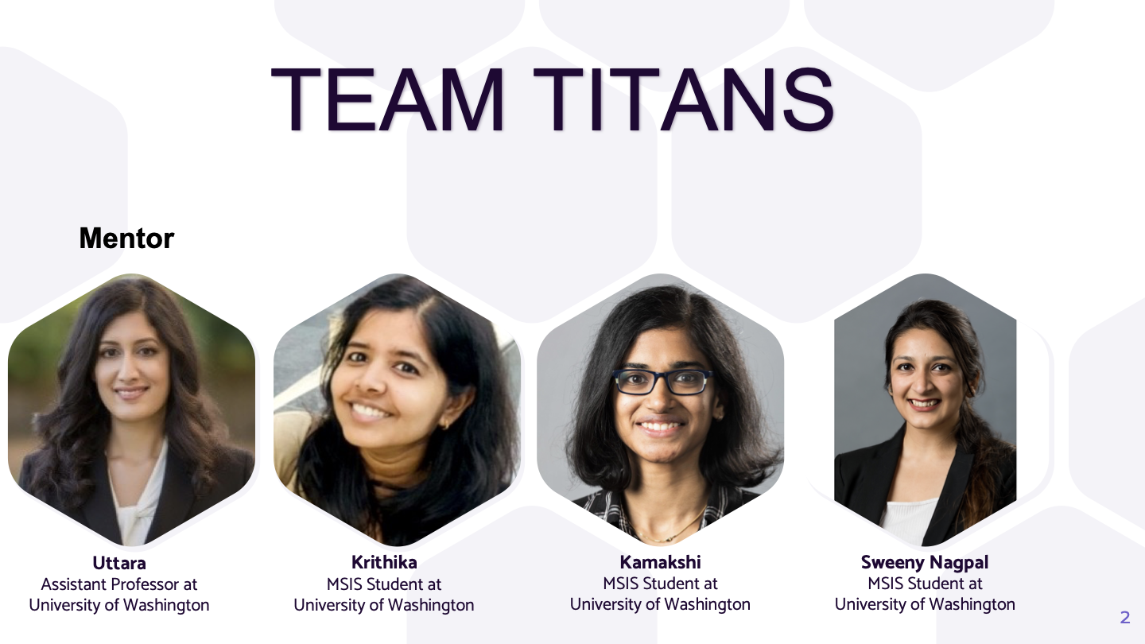

Slide 3
We shall walk you through Hiltons’…
Mobile App
Guest Categories
Mobile Browser
Mobile Browser
Travel Enthusiast
User Experience when booking via
Business Traveller
Bleisure Travellers
Web Browser
Suggest best practices and recommendations to make your business even better!!

Slide 4
THE USER EXPERIENCE
1
Mobile Browser, Mobile app and Web browser
With this analysis, we will find out if there is any difference in user activity based on device type and digital experience? Based on the results we will come up with measures to improve business metrics such as Customer engagement and satisfaction.

Slide 5

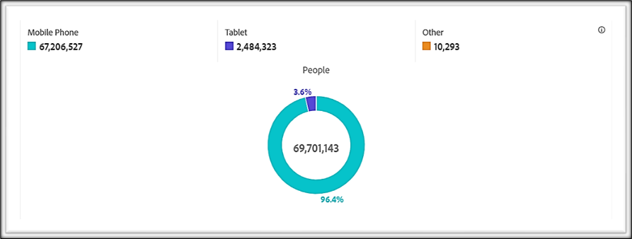
The goto Device of consumers
According to our analysis, The most frequently used device to interact with Hilton site : Mobile Phone
Approximately 97% people out of 69 million, access the Hilton website by using a Mobile Phone.
If we focus on improving the mobile experience for the users, we could increase the user engagement and the rate of digital bookings.
Notes:
In this 90-day period(Jul 13 – Oct 10), approximately 113 million people have interacted with the Hilton site.
After cleaning the data(excluding ‘No Value’ and other least used devices that doesn’t contribute to the analysis), we have the statistics of 69 million people.
Out of this 69 million, 97% of them access the site through a mobile phone making it the most frequently used device by Hilton guests.

Slide 6
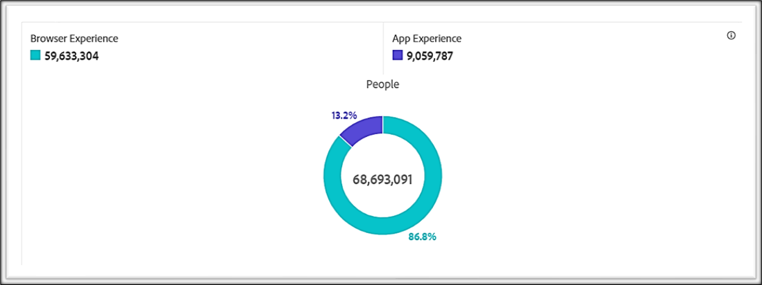
Browser Experience -
Mobile App vs Mobile Web
Diving deep into Mobile Phone experience :
Mobile Web : ~87% people use Mobile web browser to access Hilton website.
Mobile App : ~13% people use Mobile app to access Hilton site.
Mobile Web Browser is the most popular experience.
Notes:
Now that we know that Mobile phone is the most frequently used device, let’s take a closer look at the difference in usage of mobile app vs browser.
Out of the 69 million people who accessed the site during this time period, 87% of the users used a mobile web and the rest 13% through mobile app.
This makes mobile web the most popular experience among Hilton guests.

Slide 7
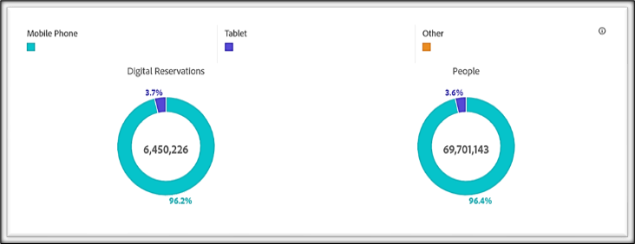
Do all visitors become guests?
Do all visitors make a reservation ?
~6 million reservations have been made out of 69 million user interactions.
96% users have used Mobile Phone to make a reservation.
Need : Increase the user conversation rate.
Notes:
Now we should take a look at how many of these site visits are getting translated into reservations.
Out of the 69 million users who interacted with the site during this 90 day period, 6 million of them have made a digital reservation.
And 96% of this reservation is through our most frequently used device Mobile phone.

Slide 8
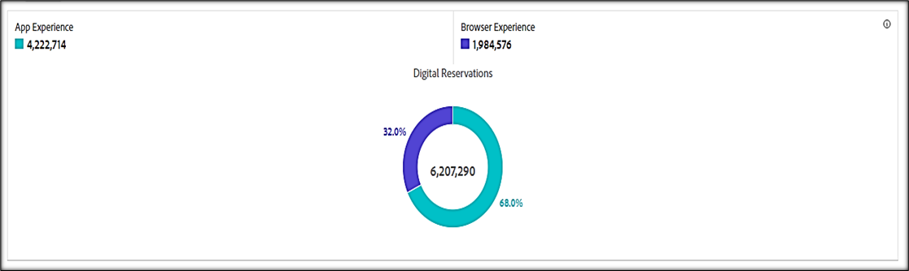
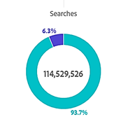
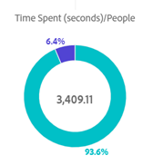


Insights: Mobile Web vs Mobile App
Time Spent (seconds)/People
Average time spent on browser(50min) is higher than average time spent on Mobile App (3min) .
Digital Reservations:
Number of digital reservations is higher for Mobile App (68%).
Number of Searches: Number of searches is higher through Mobile App (97%) .
Even though Mobile Web is popular, the User Conversion rate of Mobile App is higher than the Web experience based on the analyzed metrics.
Notes:
Here comes the interesting insight, even though mobile web is the most popular experience among users the number of digital reservations is higher through app.
Out of the 6 million digital reservations, almost 68% is reserved through mobile app.

Slide 9
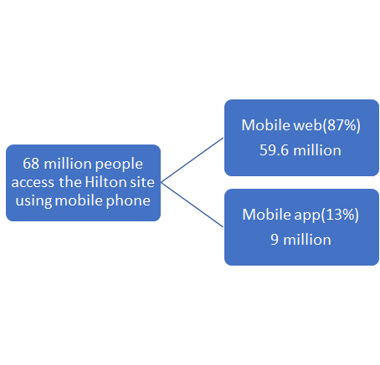
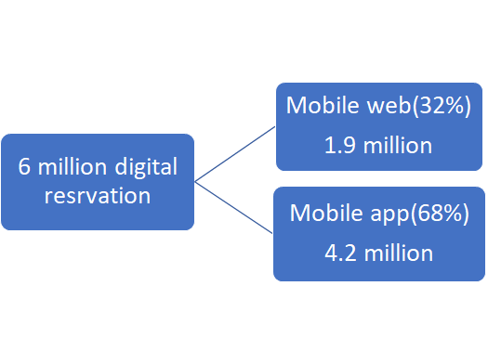
Who’s the winner?
Though Mobile web is the most popular experience among Hilton users, when it comes to converting these site visits to digital reservations, Mobile app has a higher conversion rate.
Hilton can focus on improving the mobile web experience for users.
Let’s further analyse if the guest type contributes to this difference.

Slide 10
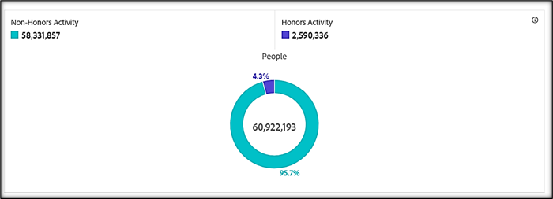
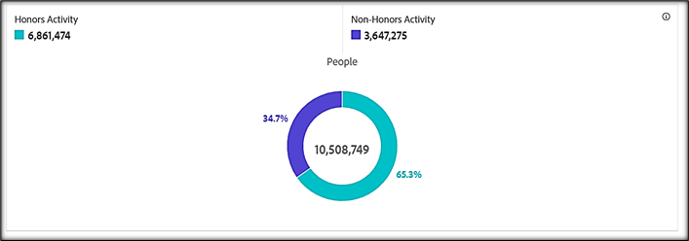
Difference in usage of mobile web based on guest type (Honors vs Non-Honors)
Difference in usage of mobile app based on guest type (Honors vs Non-Honors)
Notes:
When it comes to guest type, almost 95% of the people who use the mobile web are non-honors users.
And with mobile app, 65% of the users are from the honors tier.
Inference - Users from the non honors category mostly use the mobile web and the honors tier find mobile app to be more convenient.

Slide 11
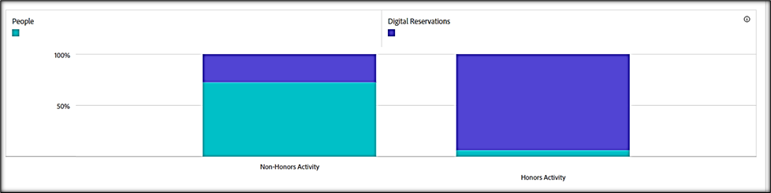
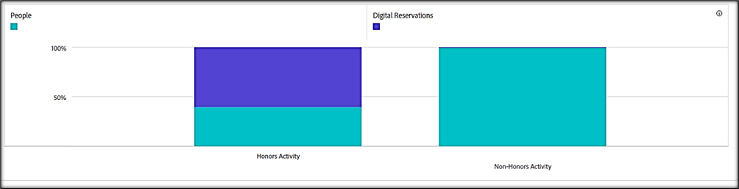
Digital reservation in mobile browser based on guest type (Honors vs Non-Honors)
Digital reservation in mobile app based on guest type (Honors vs Non-Honors)
Notes:
We have used a 100% stacked graph to show difference in percentage of digital reservation based on guest type.
Image 1) -> Almost 30% of the non-honors users and 95% users from honors tier who visit the site using mobile web make a digital reservation
2) With mobile app, almost 60% of the users from honors tier make a reservation but the percentage of reservation from non-honors users is closer to 0%.

Slide 12
Does the guest type drive the difference in digital experience?
Users from the honors tier use both mobile web and app but non-honors users highly prefer mobile web
Possible reasons:
Web browser might be more popular especially among non-honors(occasional/leisure travellers) because it gives consumers a sense of control. They need the fulfilment of having chosen the best deal, and so they access different channels, compare all relevant options and search for details before reaching and committing to a decision.
Occasional travellers don't want the hassle of downloading an app for just one time use that occupies more space on their phone.

Slide 13
Recommendations
Improve Mobile Web Experience(Hilton.com) with a focus on non-honors users:
Apart from providing information about the hotel property and its proximity from popular destinations, Hilton can also provide information about nearby restaurants,day trips and retail options. So users don’t spend much time browsing these information in other sites.
Supporting Mobile Wallets
Websites that have mobile friendly payment options like Apple pay and Google Pay see higher conversion rates. Since these payment options are fast and secure,customers will have minimal friction at checkout.
Rendering contactless services :
Like users from honors tier, non honors users should also be able to check in/check out,through contactless service. A guest messaging platform can be implemented that send users a link by text or email, allows to select their desired room and fill in personal information in advance.This also removes the hassle of having to download the app for occasional travellers..

Slide 14
GUEST CATEGORIES
2
Business Travellers, Leisure Guests, Bleisure Guests
Here we are discussing the different metrics that can help us differentiate the intent of the guests travel and measures to improve key business metric such as length of stay and gross net income.

Slide 15
How to Identify the Business Traveller??
Destination
Search Category
Honors Tier Membership
The business travellers can be filtered based on their travel destination and season of travel.
Business trips are less likely to be conducted during Thanksgiving or Christmas holidays
Hilton hotels in island Destinations like Hawaii, Coronado can be filtered out for business travelers
The search category and no.of rooms booked play a vital role in differentiating business vs leisure guests.
When the no.of adult searched is >1 and the no.of rooms booked >1, we can assume the target customers stay at Hilton for a business travel.
On the other hand when # of adults >1 and Digital Rooms night =1, they could be family/couples who stay for leisure
Frequent Business Travellers who stay at Hilton would obviously be members of the Hilton Honors tier and their choice of Property Tier maybe the Upscale Class or Upper Midscale Class based on the budget

Slide 16
Filtering the Leisure Guest
Season
Most of the vacation travels are focused during Holiday Season(Thanksgiving, Christmas, New year) and during Summer closer to weekends or before long weekends
Head Count
The search category # of Children help sort the guests who travel with kids; similarly the search of # of adults >1 who book single room can be assumed to be travelling for vacation
Destination
The guests staying at Hotels/Resorts located on islands or nearby Tourist attractions can be classified as tourists. Eg: The people staying at Hilton Tokyo Bay are predominantly guests who visit the Disney Land

Slide 17

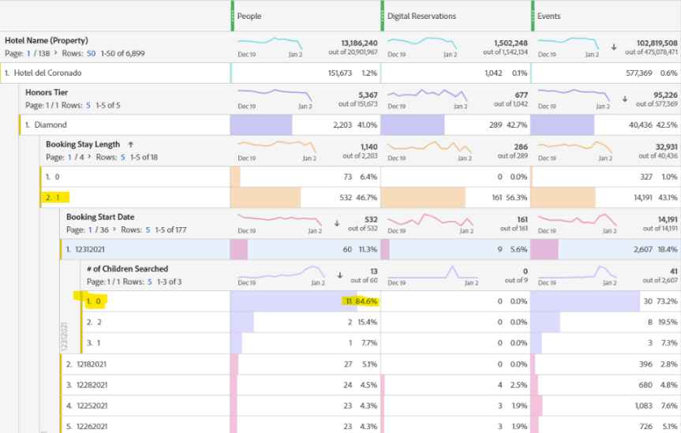
Insight 1 : Christmas season within US
Hotel del Coronado the highest occupant hotel of Hilton during Christmas/New Year season within US, 2021.
The maximum booking stay length by about 532 guests was just for 1 day during the holiday season.
Identifying these guests as Couple-travellers, if we could potentially try to increase the duration of stay by another day, it would increase the hotels revenue.
Notes:
Recommendation:
The above data is for the most occupied hotel in 2021 within US during holiday season. Assuming the travellers who stay only for a day to be solo travellers or couples, if Hilton sorts all the guests who stay for a day (during holiday season), finds creative ways to extend their stay by another day, there will be a potential increase in their revenue for their last quarter (Q4).

Slide 18

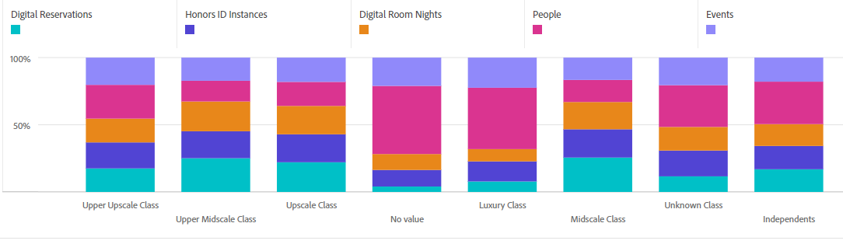
Insight 2 - Sort Bleisure guests based on Property Tier preference
Leisure travellers prefer the ‘Upper Upscale Class’ hotels/resorts located at tourist destinations with high end amenities.
Business travellers focus to stay at ‘Upper Midscale’ or ‘Upscale Class’ hotels located at downtown areas, or centres closer to office premises.
The Bleisure travellers are business guests who can potentially extend their stay by another day for leisure purposes. We can narrow down the search by filtering out resorts/condos and those located at city centres eg: Palmer House, Hilton Chicago.
Business Travellers
Leisure Guests
Bleisure Guest
Notes:
Inference:
The Hotels are categorized into various Classes based on amenities, popularity and location. Thereby their occupancy, guest categories and membership activity also varies.
Most of the high revenue earning hotels located at famous tourist attractions are listed under ‘Upper Upscale Class’ whose occupants mostly are ‘Leisure Travellers’. The business travellers prefer hotels under Upper Midscale and Upscale Classes.

Slide 19
Suggestions for Profit Improvement
Revenue increase for Q4 - Analysing the past 3 years(2019-2021), quarterly reports Hilton has a very profitable third quarter. Their 4th quarter income can be improved considerably, especially being the holiday season. If Hilton focuses on increasing the guest count and length of stay in their leisure destinations, Q4 can be equally profitable as Q3.
Based on the geographical location of the user searching and time of travel information, Hilton could suggest destinations under the ‘Top Picks’ section. Eg: A user located at Chicago browsing in fall can be suggested hotter places like Hawaii/Florida to spend their New Year.
Hilton could also sort the bleisure travellers who are most likely Honors members and provide offers to extend their stay or transform the purpose of travel.

Slide 20
THANKYOU…

